Slide 1
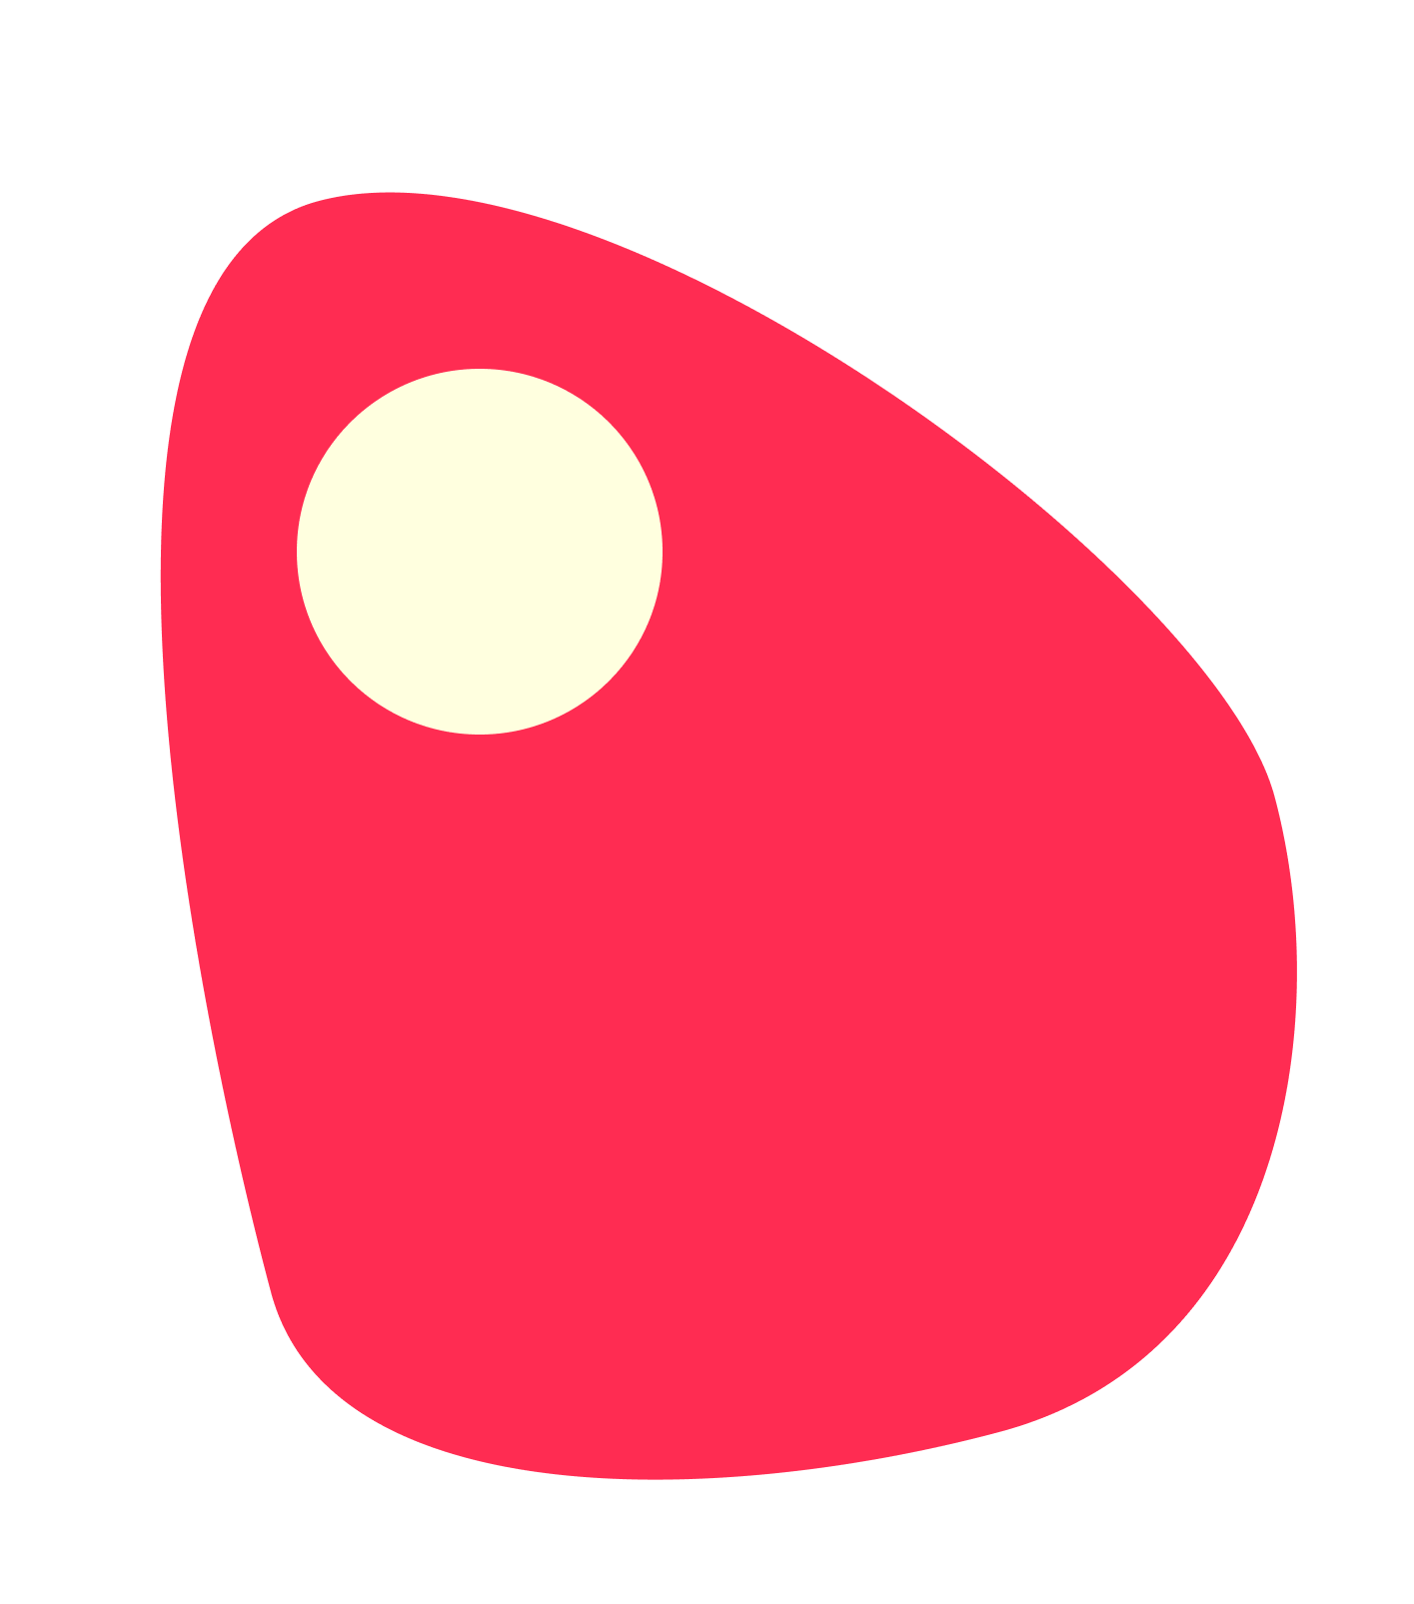
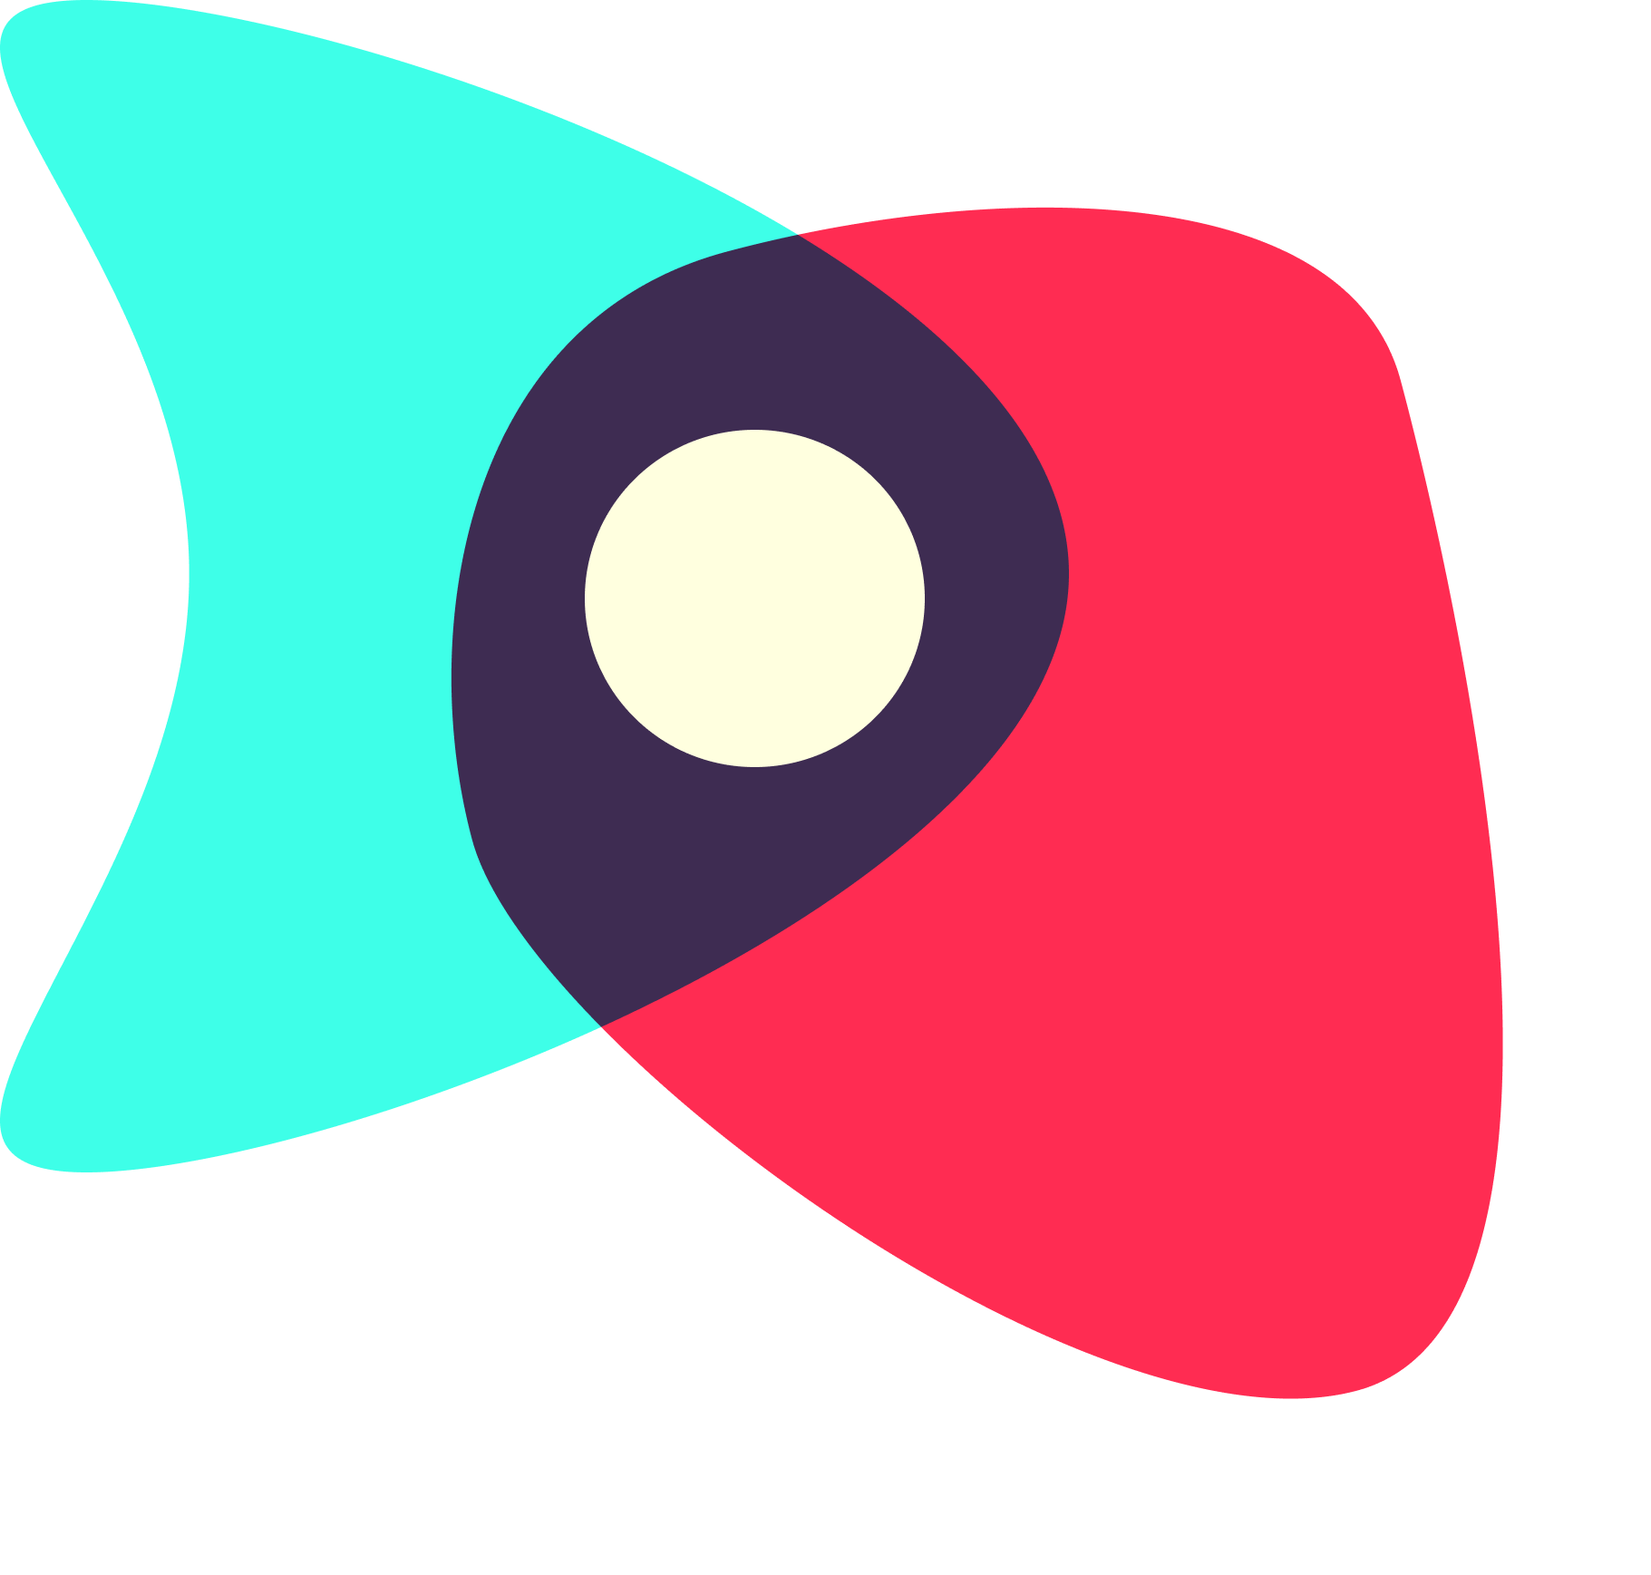
Digital Democracy:
Interactive Medium-Fi Prototype
Sharewaves
Garrick F. | Gen S. | Grace W.
Notes:
New title slide

Slide 2
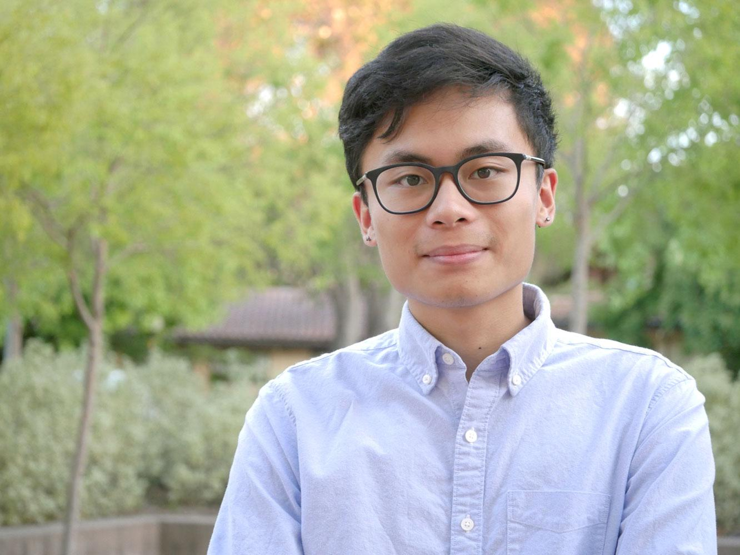

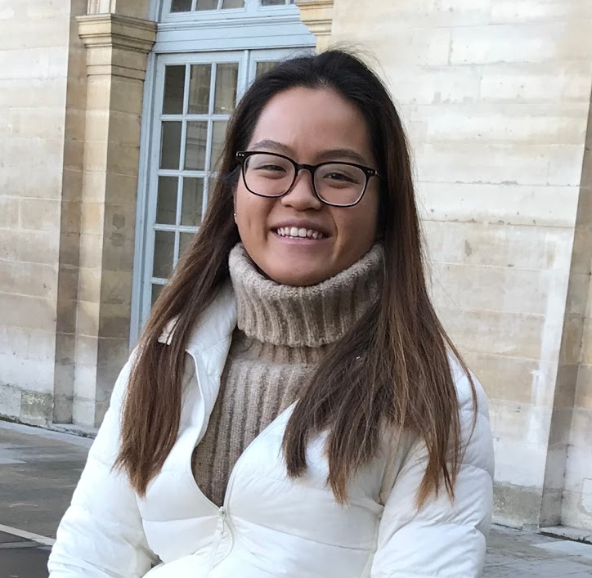
Garrick
Gen
Grace
Coterm, CompSci
fergalicious def
Senior, SymSys
shakira, shakira
Senior, Econ
soulja boy tell ‘em!
Our mission is to help people harness the activation energy from reading and sharing news into getting involved with political issues in their own communities.
Notes:
Introduce team and mission

Slide 3
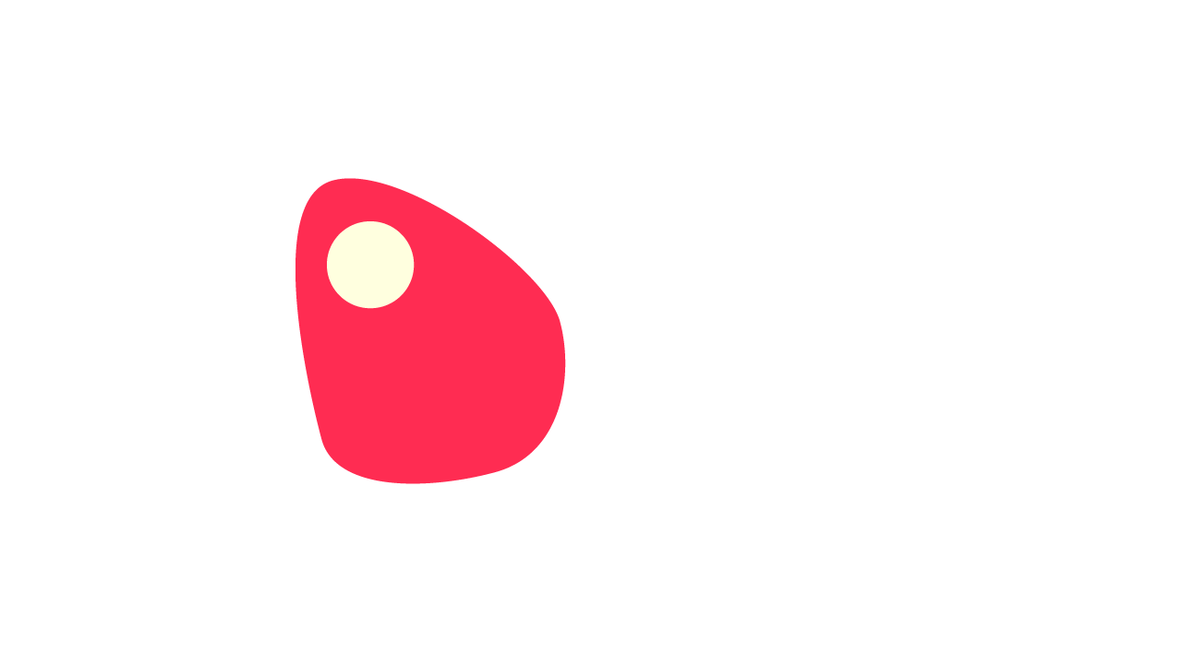
The Problem
Online communities, discourse, and news divide and isolate people, leaving them feeling hopeless, unenergized, and without clear ways to participate in politics.
Notes:
Introduce problem (There are already ways people read and share news out there, but in our needfinding and EP testing we saw people who were unenergized and feeling hopeless. When you read the news a common feeling you get is “what can I do about it”)

Slide 4
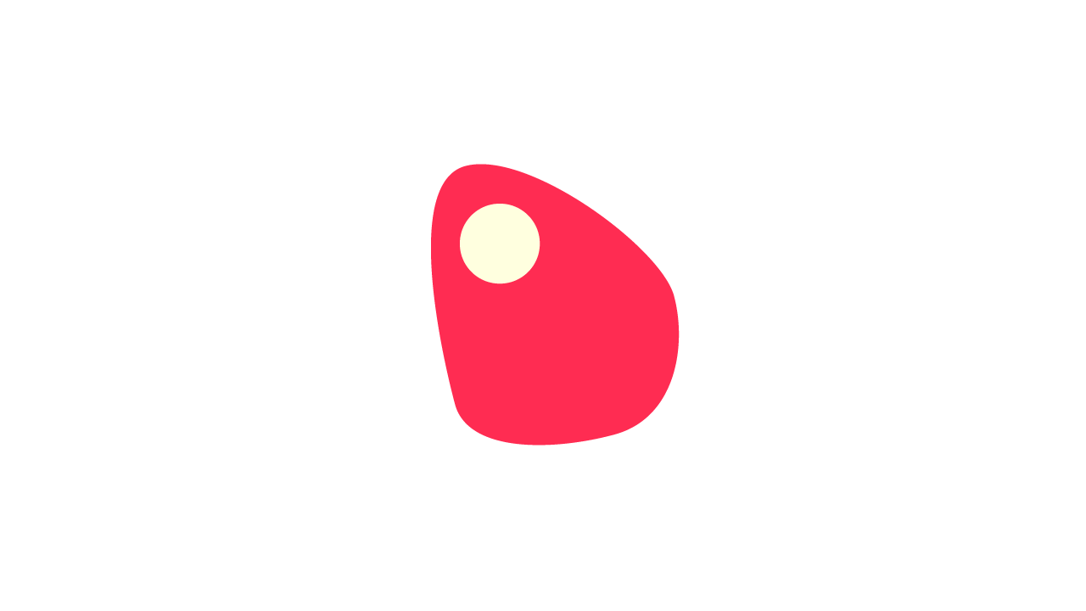
The Solution
We provide a platform for people to rally around stories they care about, see people like them, and get offline—sparking political conversation and action in their communities.
Notes:
Introduce solution (We are the thing you can do about it. idea is to get offline!!!)

Slide 5


Notes:
Here’s our name and value proposition. With our app, you can see the changes happening in your communities and contribute to it, and it’s just an extra no-frills layer on top of the news-reading experience.

Slide 6
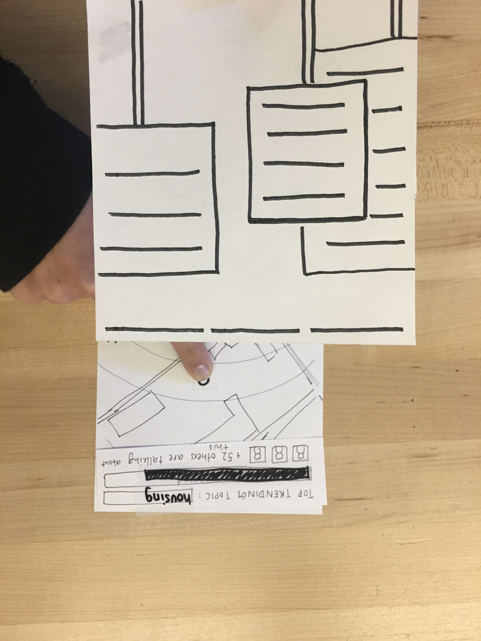
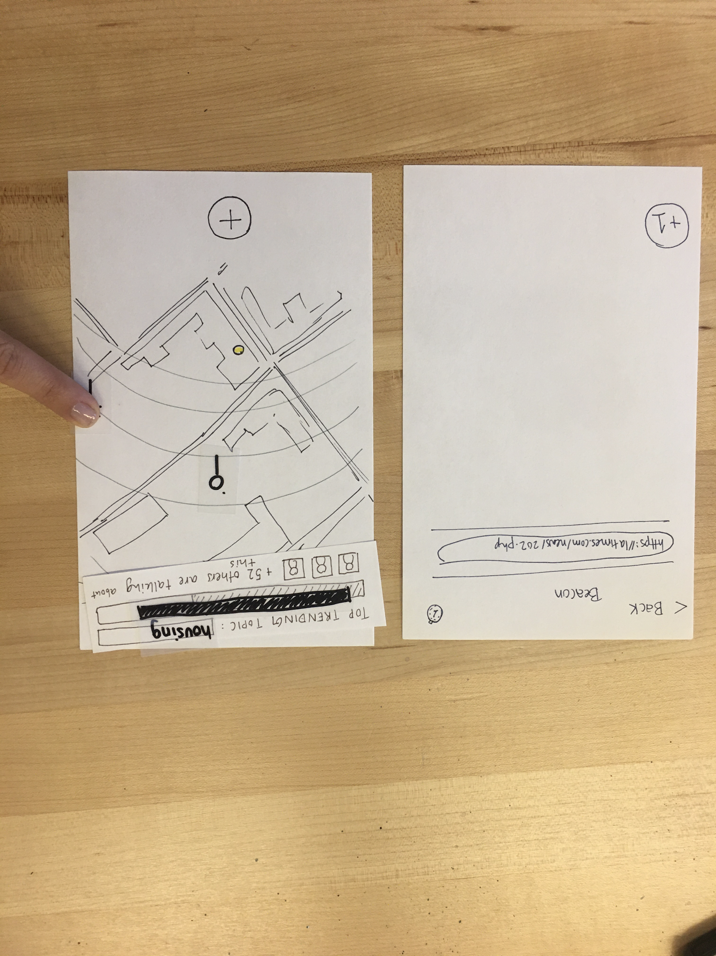
Simple task: discover nearby stories
Users click on a pin on the map to open either a video or a news story shared by nearby users.

Slide 7
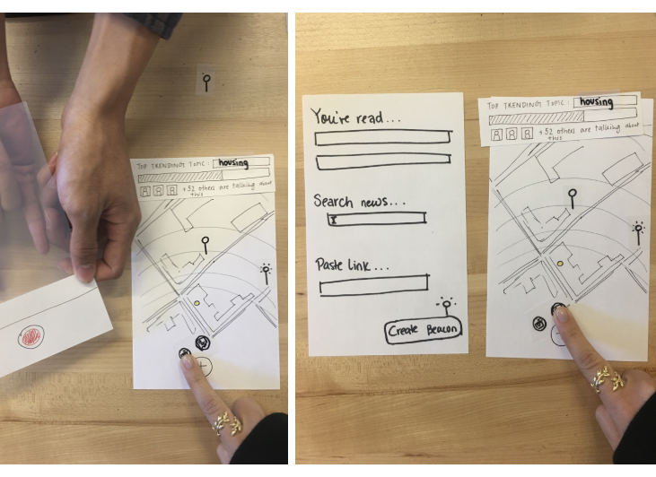
Medium task: share your stories
Users can click on the ‘+’ button and choose to share either a video or a news story.

Slide 8
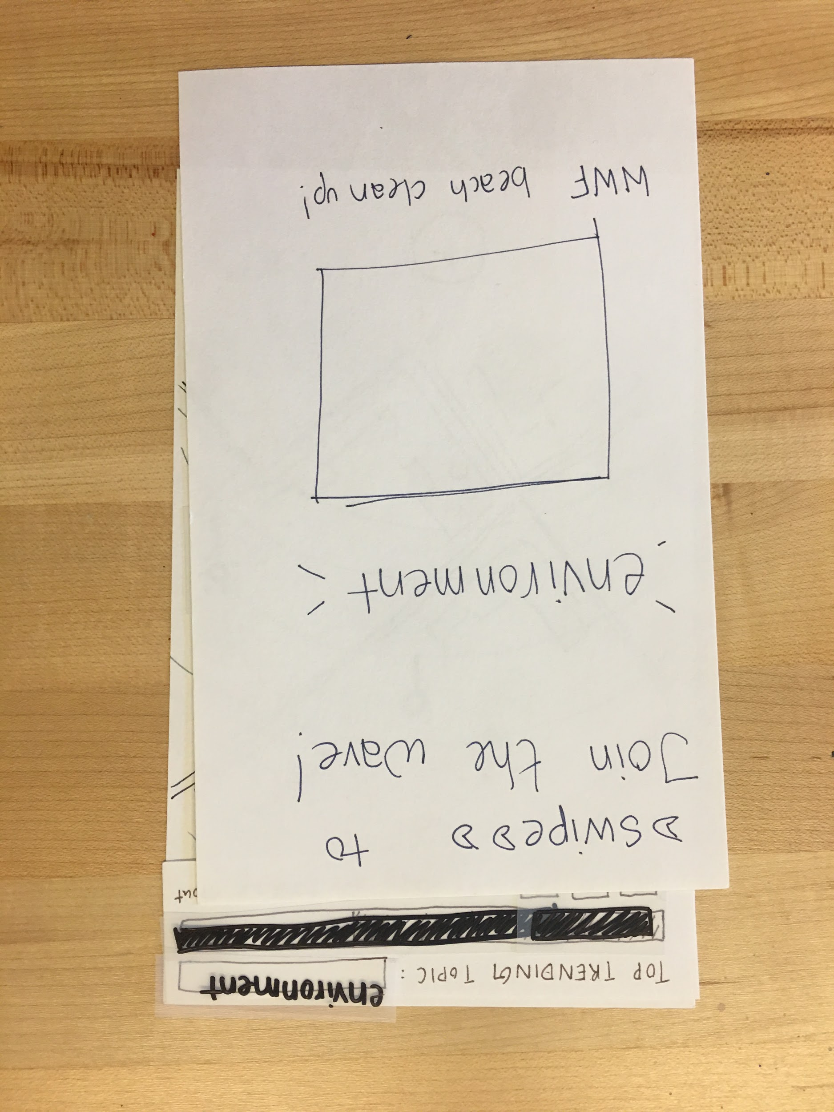
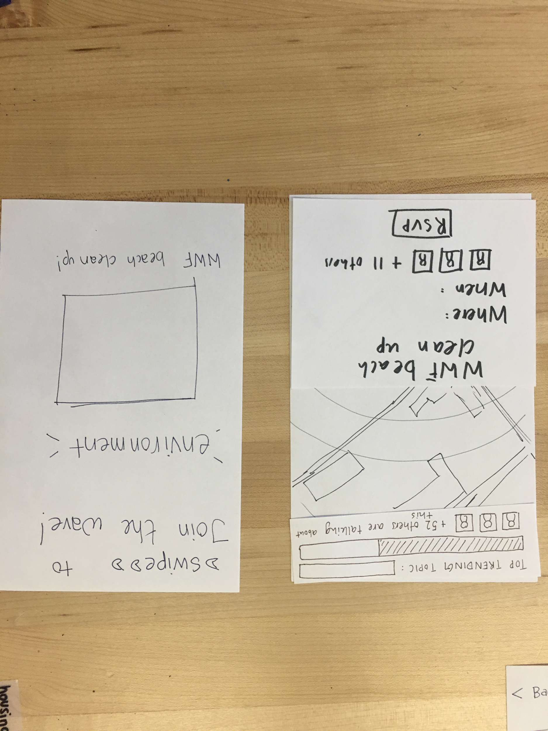
Complex task: spark offline activity
When there is high levels of interest in a particular theme, users can learn more about and participate in offline political activity.

Slide 9
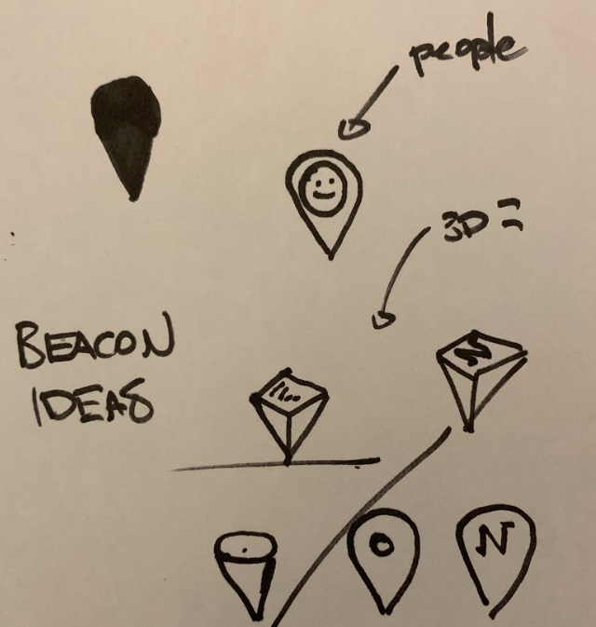




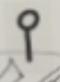
Major Design Changes: Pin
We decided to ideate on the pin idea since we received feedback that our pin could convey more information (e.g. if the pin represented a video or a news story).
Low-fi
Ideation
Med-fi
Generic pin
Pin to show news
Pin to show video

Slide 10
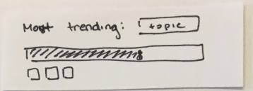
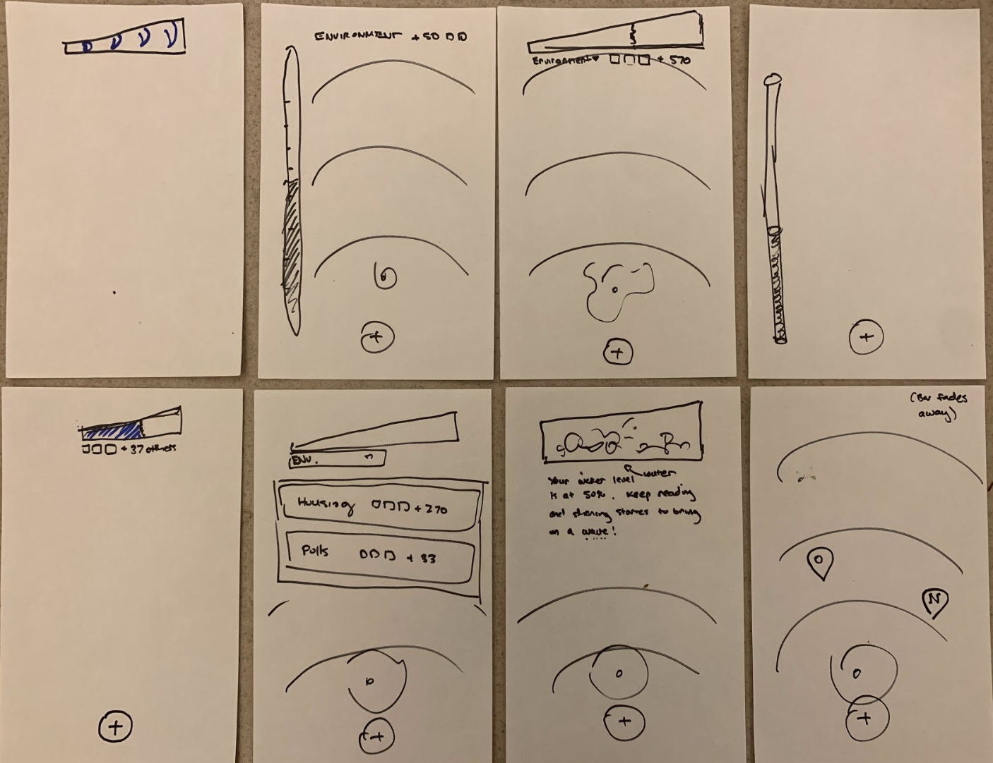
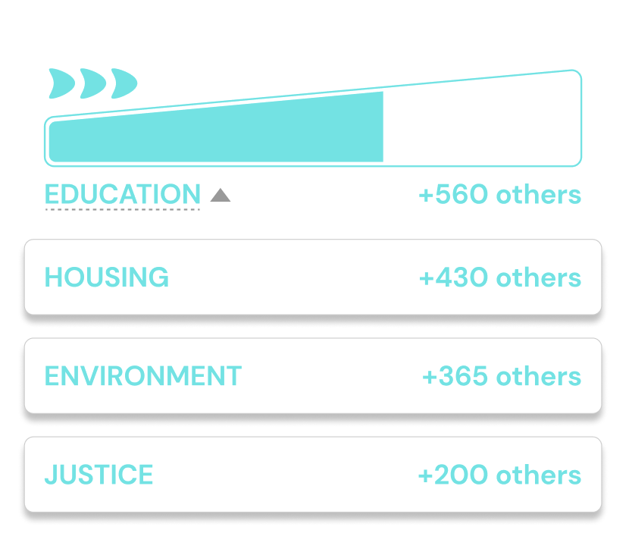
Major Design Changes: Trending bar
Our low-fi bar caused confusion among participants. People weren’t sure what the bar represented, or thought it represented progress in a game.
We wanted to better communicate the idea of ‘riding the wave’ of interest in a topic, and let users click on the bar and explore different trending topics.
Low-fi
Ideation
Med-fi

Slide 11
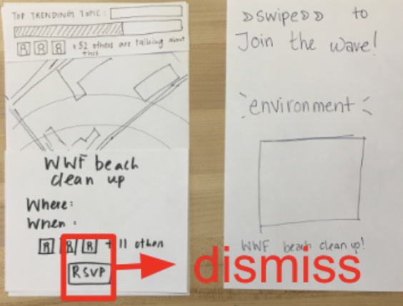
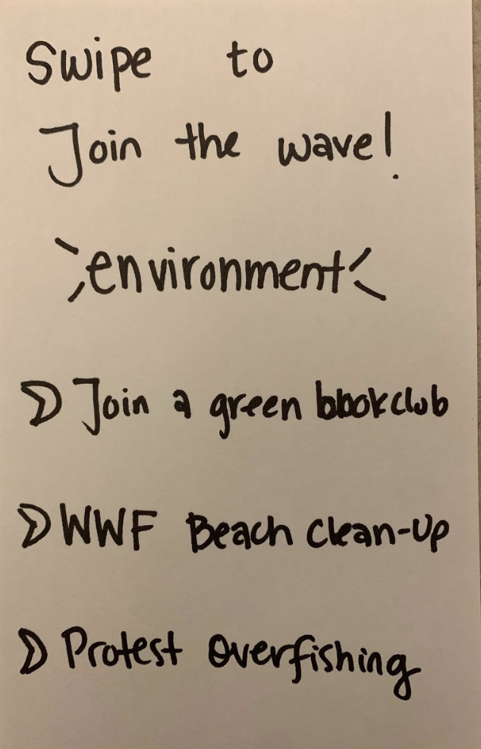
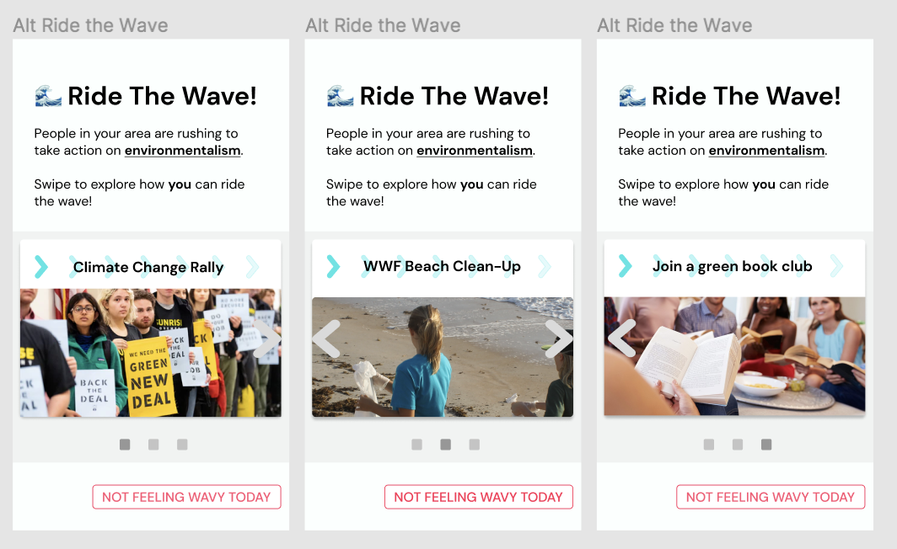
Major Design Changes: Ride the Wave Screen
People were suspicious of our pop-up “Ride the Wave” screen, which showed just one event.
In our med-fi prototype, we allowed users to choose from several different options with varying levels of engagement.
Low-fi
Ideation
Med-fi

Slide 12
Medium-Fi Prototype Task Flows

Slide 13
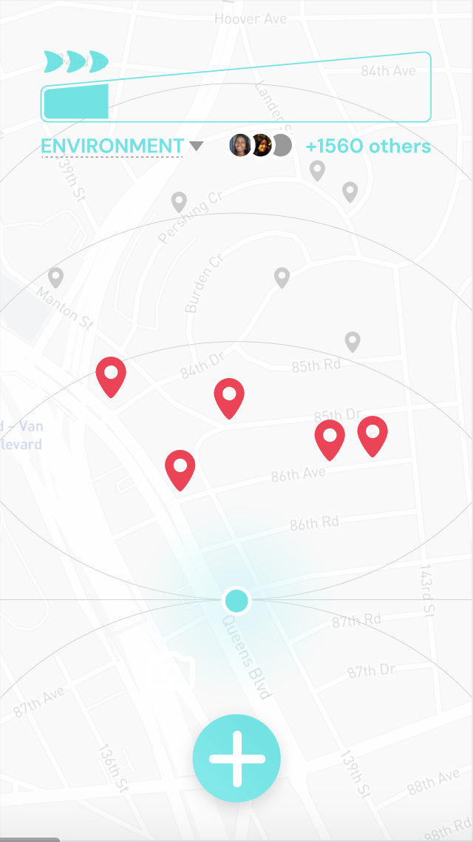
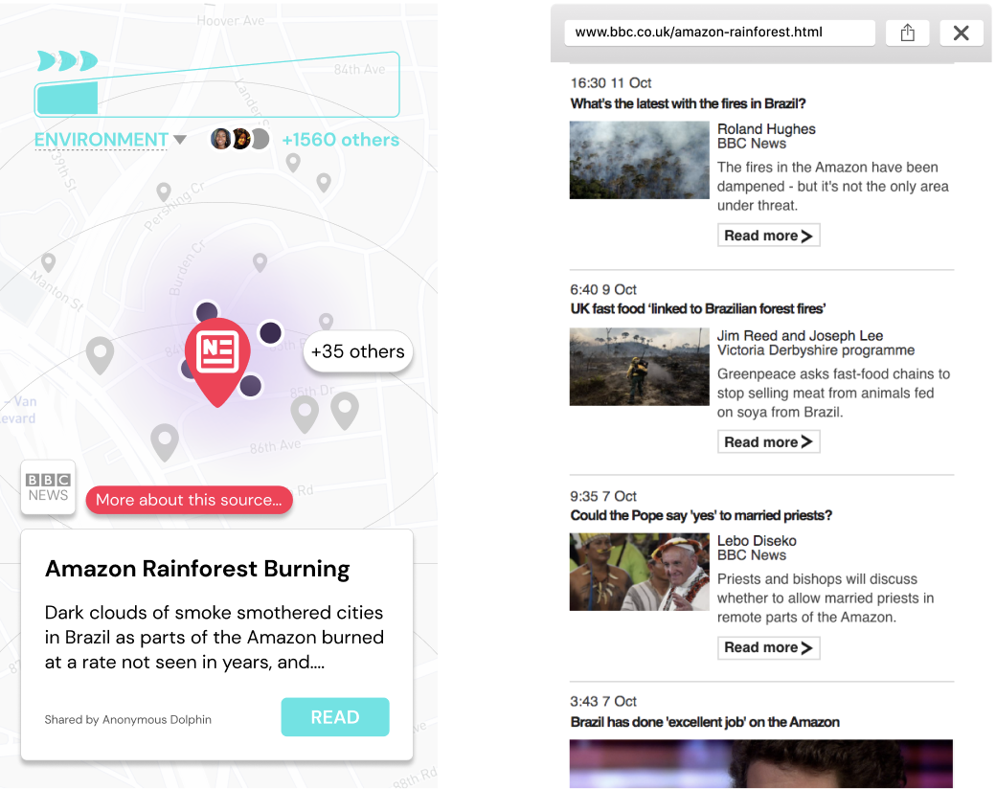
Simple task: discover nearby stories

Slide 14
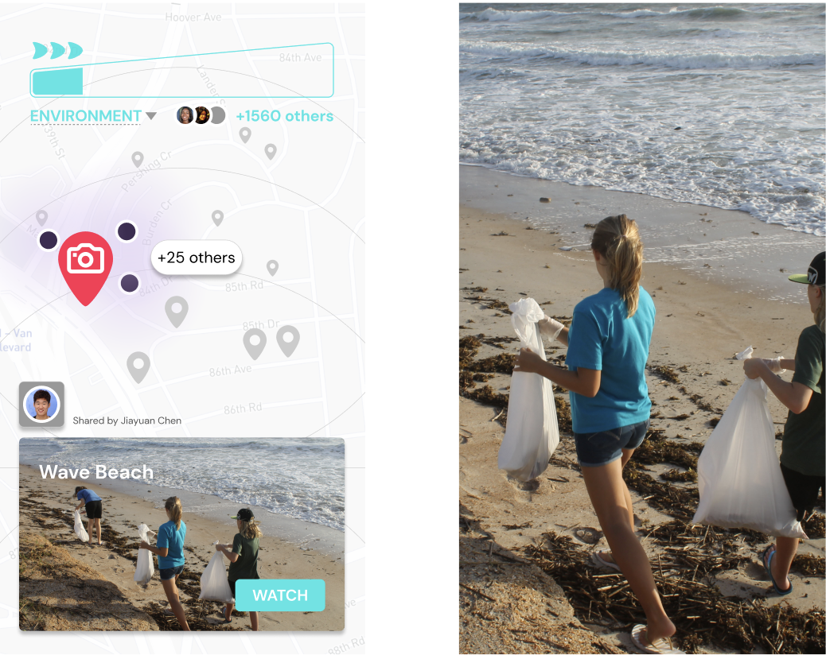
Simple task: discover nearby stories

Slide 15
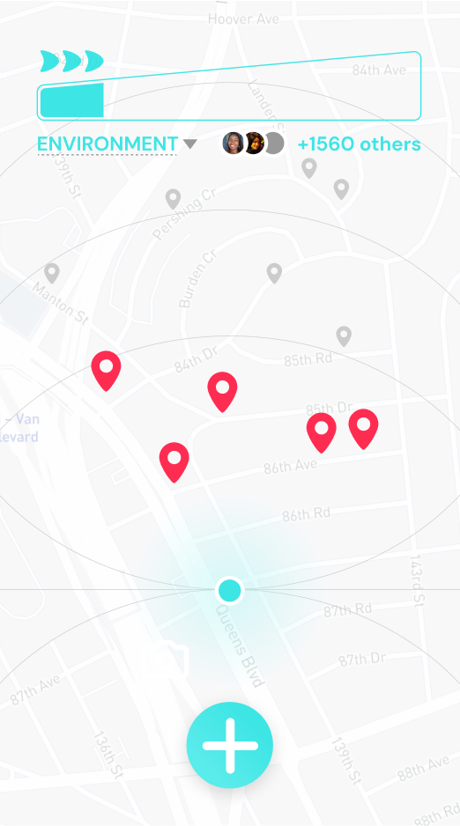
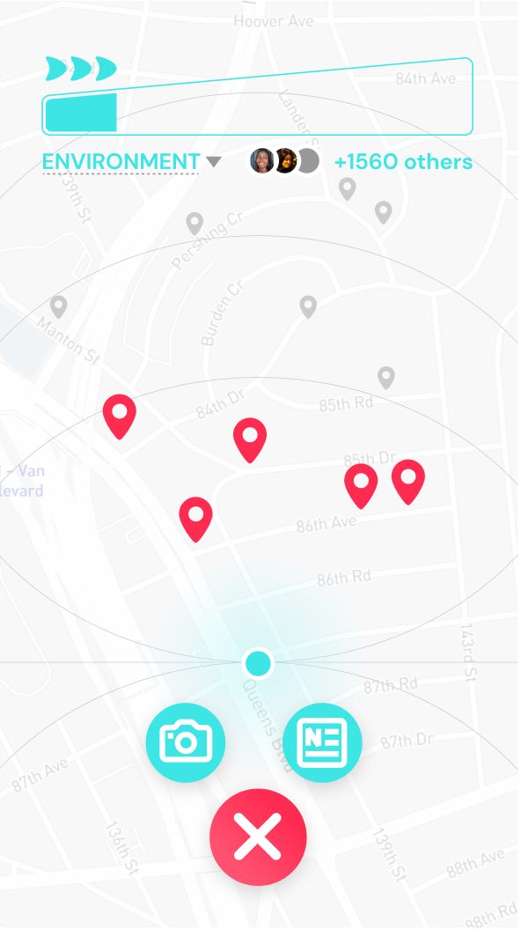
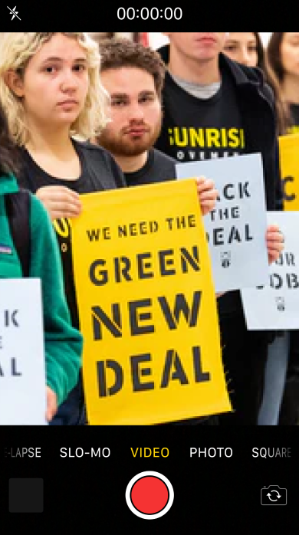
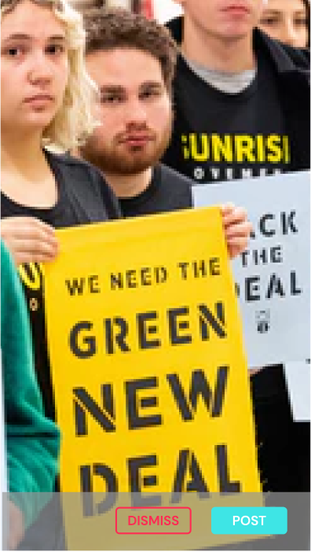
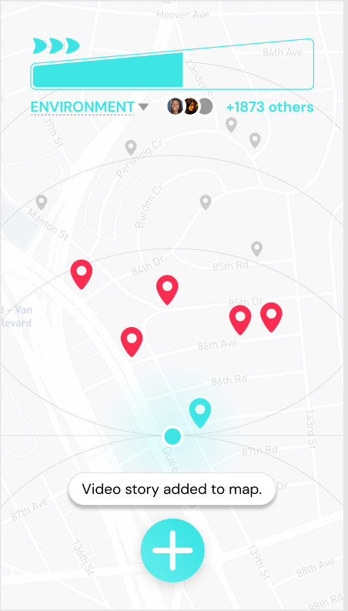
Medium task: share your stories

Slide 16
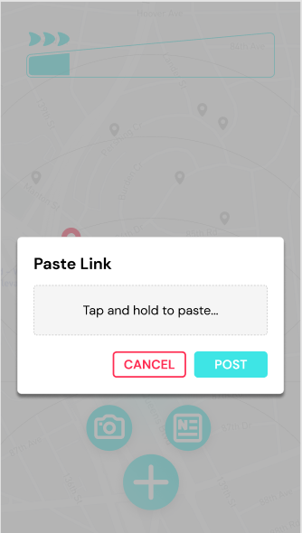
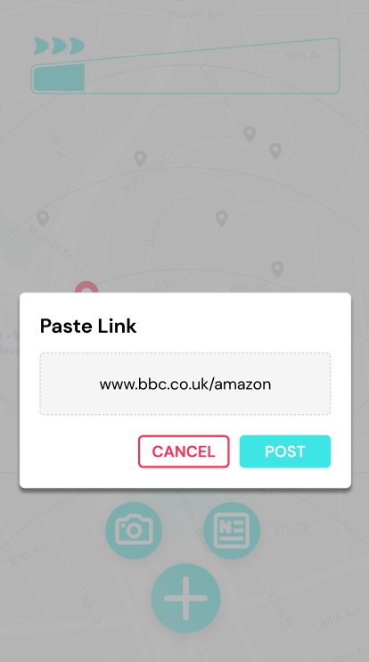
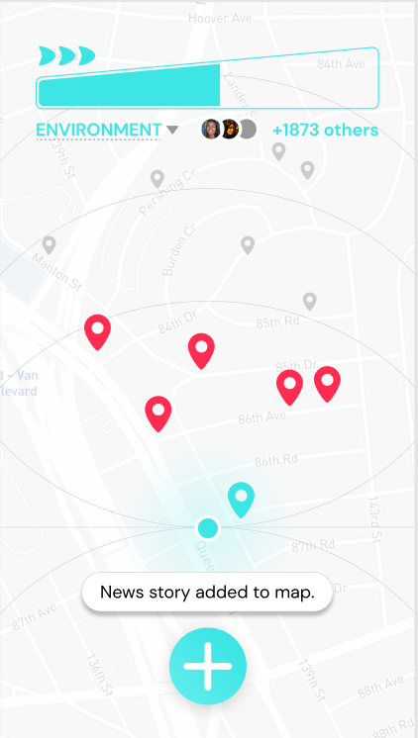
Medium task: share your stories

Slide 17
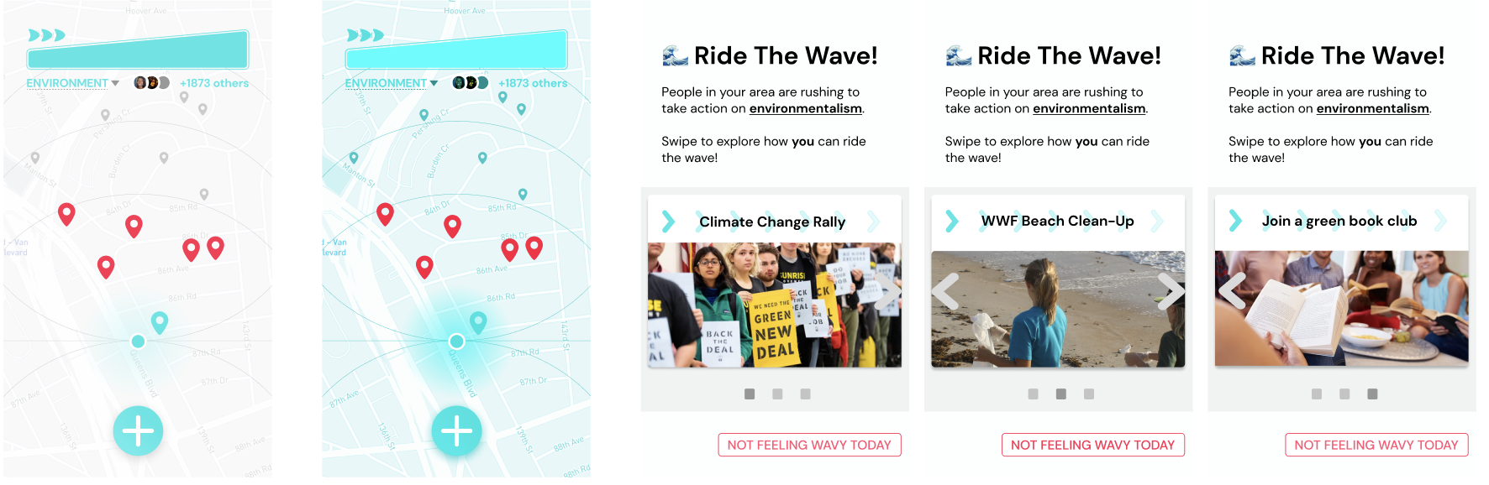
Complex task: spark offline activity
Waves are triggered when the bar is full. Users swipe through options.

Slide 18
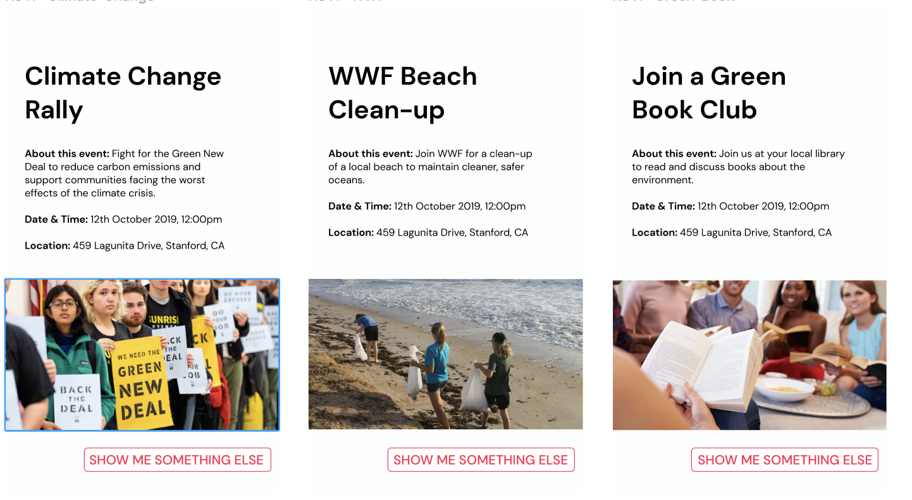
Complex task: spark offline activity cont.
Select an option, then...

Slide 19
Prototype Overview
a. Design/Prototyping Tools
Used Figma (both UI design and interactive prototype flow) and Figma Crush for design inspiration
Tools helped:
All contained in one collaborative, real-time, intuitive platform: independent design work informed by others
Didn’t have to create UI from scratch
Easy to make transitions
How did the tools not help? (what was hard)
Keeping track of screens and naming thing
Hard to maintain state (have to hardcode some)

Slide 20
Prototype Overview
b. Limitations/tradeoffs of the current prototype (what was left out of the prototype & why)
Some actions aren’t mocked: actions beyond the task flow were not included because they distracted from the core elements of the application
No real information/ database: not a real application, so it is not connected to a back-end
c. Any Wizard of Oz techniques required to make it work
None
d. Hard-coded features and why required
Because sharewaves is a social app and we do not have users, we do have hard-coded content. We created mock users, news stories, and videos to simulate a full user experience.

Slide 21
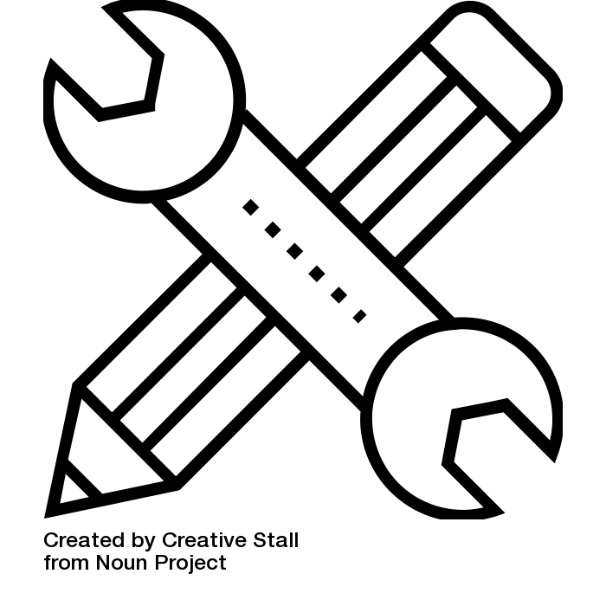
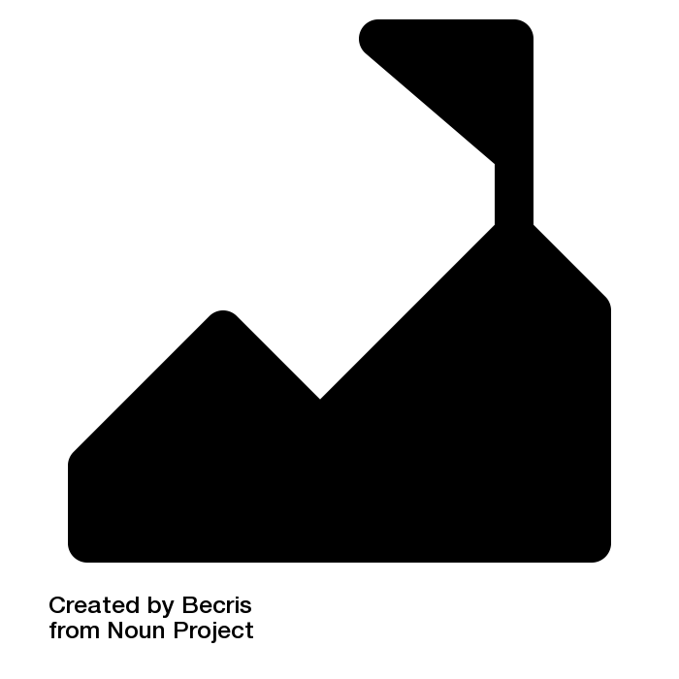
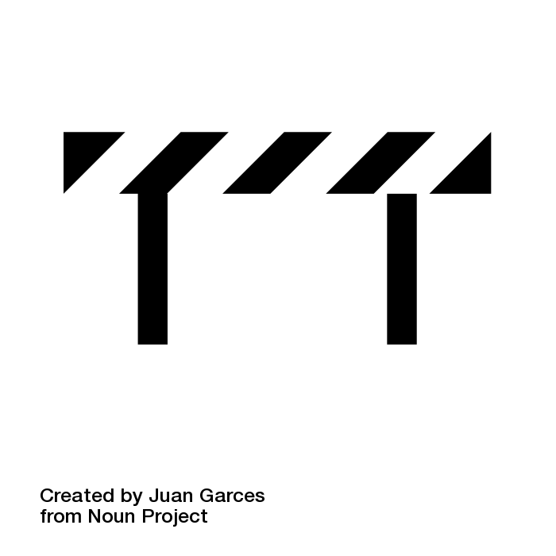
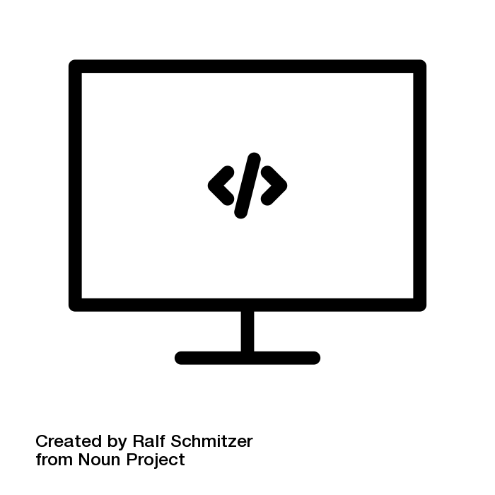
Med-Fi Methodology
Tools?
Figma
collaborative design, interactive prototype flow
Figma Crush
inspiration, re-use of relevant components
Challenges?
Tools helped…
-collaboration
-intuitive platform
-easy transitions
Tools didn’t…
-keeping track of / naming designs
-state management
Limitations
What’s left out?
-some actions are not mocked: focus on core interactions and elements
-no real information/ data (no back-end)
Hardcoding?
(since we’re a social app with no users…), we created mock users, news stories, and videos to simulate a full user experience.
No wizards required!

